Slide 1
Embedded system
Linux on Embedded system
HCMUTE – Faculty of Mechanical Engineering
Lecturer: PhD. Bui Ha Duc

Slide 2
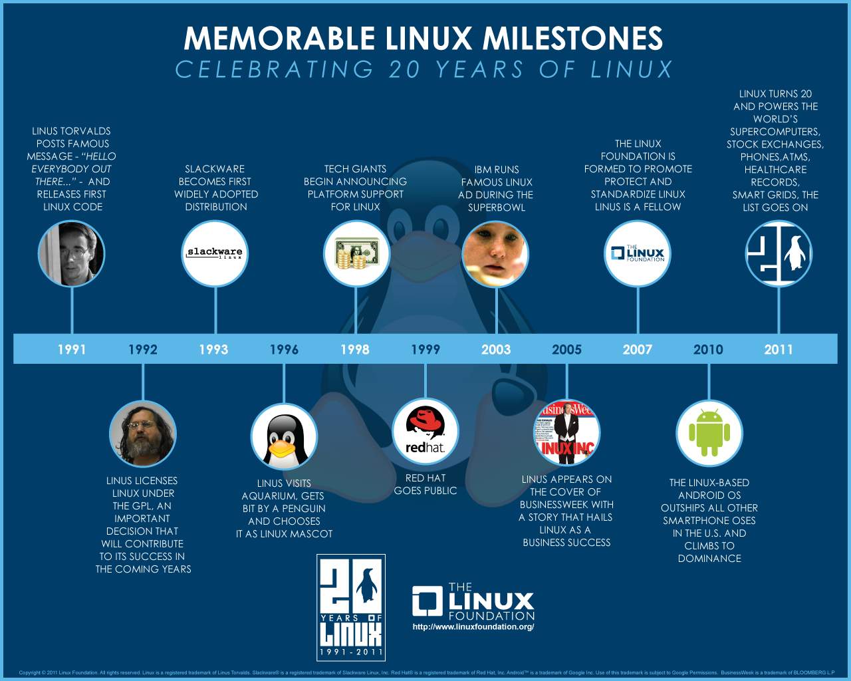
Notes:
In 1991, in Helsinki, Linus Torvalds (21 yrs, student, Finland) began a project that later became the Linux kernel. He wrote the program specifically for the hardware he was using and independent of an operating system because he wanted to use the functions of his new PC with an 80386 processor. 4 month , C language
he needed more people to help him hence, 1992 given general public license. At first, only people with extensive computer programming knowledge would be able to do anything with that early public version of Linux. These people started to offer their help. The version numbers of Linux were getting higher and higher. People began writing programs specifically to be run under Linux. Developers began writing drivers for different video cards, sound cards and other gadgets inside and outside your computer could use Linux.

Slide 3
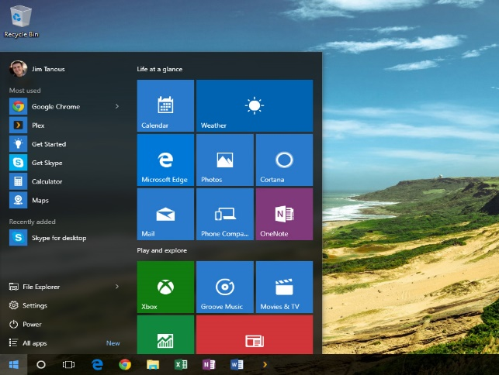
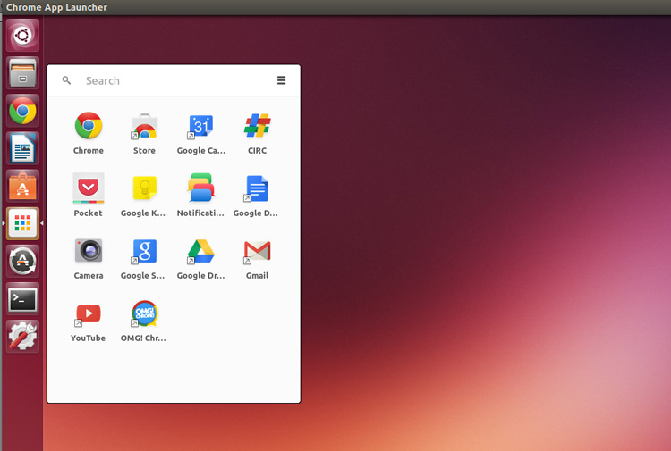
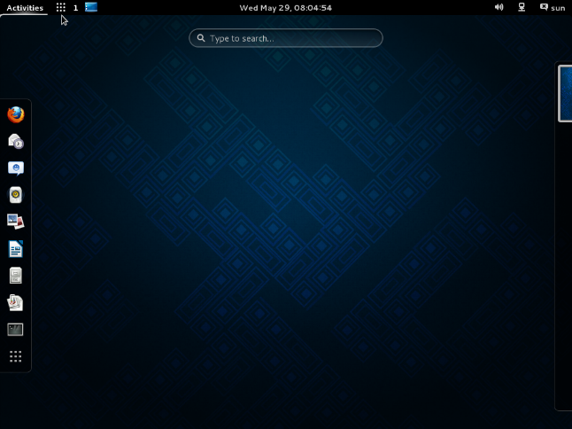
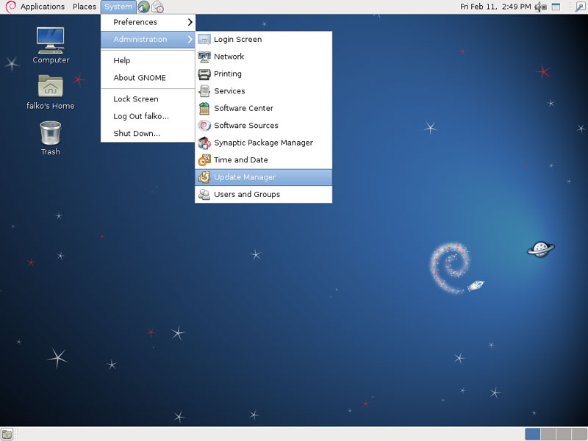
Linux vs Windows
First look - Graphic user interface:
Windows
Linux
Ubuntu
Linux
Fedora
Linux
Debian

Slide 4
Linux vs Windows
Linux | Windows
Open Source; “Free” to distribute, download, modify | $$
Can be installed on a wide variety of computer hardware (mobile phones, tablet computers, video game consoles, supercomputers) | On PC's desktops, laptops, servers and some phones
File system support: Ext2, Ext3, Ext4 | File system support: FAT, FAT32, NTFS
Text command: BASH | Text command: DOS – like commands
User interface: GNOME or KDE | Windows Aero

Slide 5
Linux process
Linus wrote his own OS kernel in 1991
Power ON
Bootloader
Kernel Init
Operating System
Bootloader:
Configuration of system memory
Loading of the kernel image and the Device Tree at the correct addresses
Optional loading of an initial Ram disk at the correct memory address
Setting of the kernel command-line and other parameters
Kernel:
The core and lowest level of the software running on a Linux system
Managing the hardware
Running user programs
Running the user program
Maintaining the overall security and integrity of the whole system
kernel are loaded into protected areas of memory so that they can't be overwritten

Slide 6
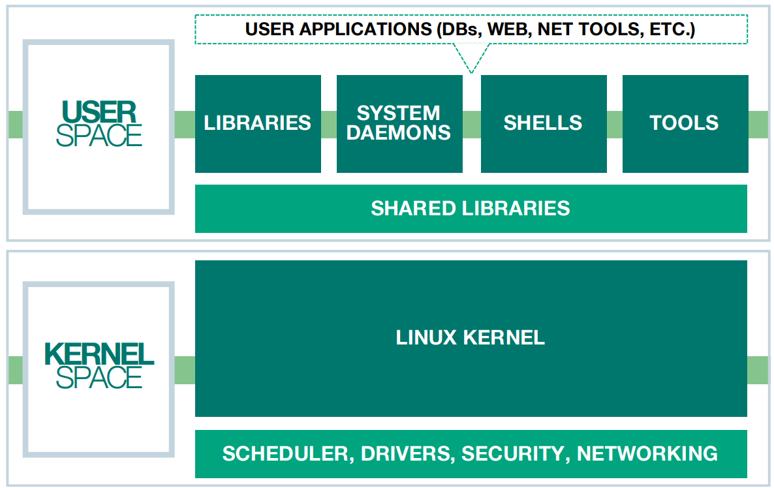
Components of an Operating System
Operating System
Open
Access
Protected

Slide 7
Linux Kernel
Kernel is the core of Linux operating systems
Official website:
https://www.kernel.org/
OS based on Linux kernel – Linux Distributions
  E.g. Ubuntu, Fedora, Red hat, Debian…
Almost 600 Linux distributions exist.
Kernel versions:
  Linux 2.6.x: Friendly Arm
  Linux 3.4.x: Orange Pi
  Linux 4.x: Raspberry, BeagleBone

Slide 8
Linux Kernel
Check your linux kernel:
  Open terminal
  Type “uname –r”
2.6.32-431.11.2.el6.x86_64
Newer version has: new features, enhancements, bug fixes, apps
Kernel Version
Major Revision
Minor Revision
Can we modify Linux Kernel ?
When ? How ?
Debug, add drivers, modify modules
How to install Linux OS to embedded system ?
Depend on board. Not easy as install linux on computer !

Slide 9
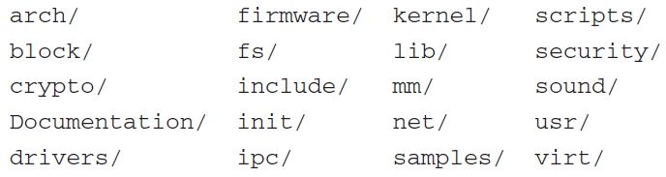
Linux Kernel Organization
/drivers: largest folder, contains drivers for numerous hardware
/arch: next largest, contains support for processors architectures

Slide 10
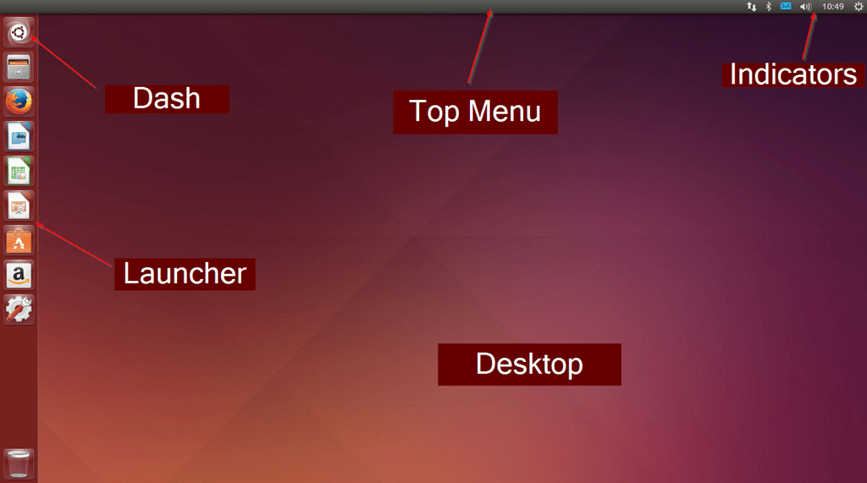
Ubuntu desktop

Slide 11
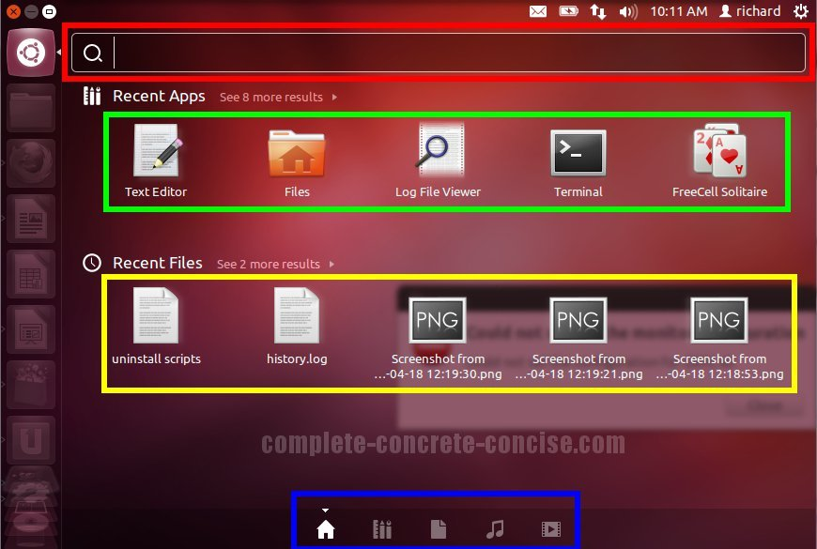
Ubuntu desktop

Slide 12
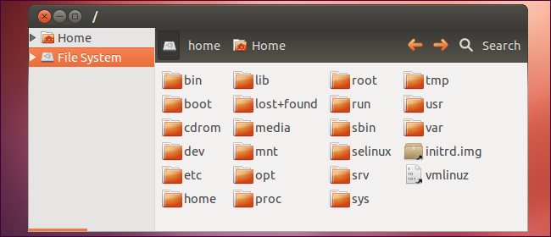
Linux File System
Top-level Directory:
/bin: Contains executable binary, commands used by all the users of the system are located here
Notes:
Armed with this knowledge, you will find it much easier to navigate this large, complex source code base.
Also, it’s easier for the developers to contribute to the linux

Slide 13
Linux File System
/sbin: contains executable binary files used typically by system administrator, for system maintenance purpose.
/etc: contains configuration files required by all programs, startup and shutdown shell scripts
/dev: contains device files
  E.g. /dev/tty1, /dev/usbmon0
/proc: contains information about running system process
/home: store user personal files
Notes:
Armed with this knowledge, you will find it much easier to navigate this large, complex source code base.
Also, it’s easier for the developers to contribute to the linux

Slide 14
Linux File System
/boot: contains boot loader related files
/usr: contains binaries, libraries, documentation, and source code for second level programs.
/opt: contains add-on applications from user, individual vendors
Refer to this link for more information
http://www.thegeekstuff.com/2010/09/linux-file-system-structure/?utm_source=tuicool

Slide 15
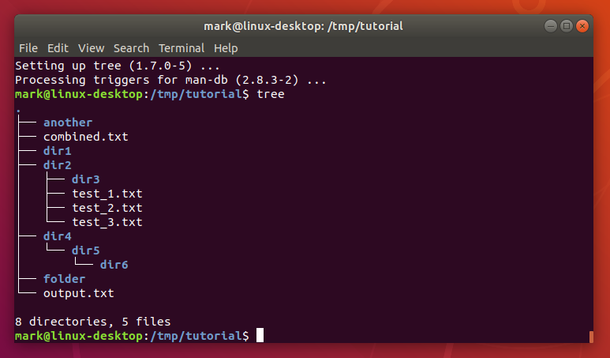
Linux Administration
Linux
Graphic User Interface (GUI)
Command Line Interface (CLI)

Slide 16
Warm up
Open Ubuntu -> Files -> Home
Create a new folder name “bai_tap”
Open Text Editor
Type “Hello world” and save as a new file name “bt_1” in Home folder
Right click on “bt_1”. Select Properties -> Permission
Change Owner Acess to Read Only, then Close
Try to edit the file and save it
Try to create a new file

Slide 17
Linux Terminal
The command line is an interesting beast
Most of time you communicate with the embedded board via Terminal
Terminal use BASH language
Linux ignores the extension and looks inside the file to determine what type of file it is.
Linux is Case Sensitive
e.g. file1.TXT ≠ file1.txt
Careful with space in file names
The Linux command line does not have an undo feature. Perform destructive actions carefuly.

Slide 18
Linux Terminal
Useful commands:
pwd – Print Working Directory
user@bash: pwd
/home/haduc
ls – list all folders and files in the working directory
user@bash: ls
bin Documents public_html
user@bash: ls -l /etc
cd [location] – move to the [location folder]
e.g. cd /usr/local/bin
cd ../games
Absolute and Relative Paths
Absolute paths specify a location (file or directory) in relation to the root directory, always begin with a forward slash ( / )
e.g. /home/ryan
Relative paths specify a location (file or directory) in relation to where we currently are in the system, not begin with a slash.
e.g. Documents

Slide 19
Linux Terminal
man <command> - Look up the manual page for a particular command.
mkdir [options] <Directory> - Create a new folder
e.g. mkdir chuyende
rmdir [options] <Directory> - Remove a folder
touch [options] <filename> - Create a blank file
cp [options] <source> <destination> - copy a file or folder
mv [options] <source> <destination> - move a file or folder
rm [options] <file> - remove a file
gedit <file> - open Text Editor to edit file

Slide 20


Linux Terminal
Permission: specify what a particular person may or may not do with respect to a file or directory
  r read - you may view the contents of the file.
  w write - you may change the contents of the file.
  x execute - you may execute or run the file if it is a program or script.
chmod [permissions] [path] - change permissions on a file or directory
- : file
d : folder
permissions
for the owner
permissions
for groups
permissions
for others

Slide 21
Linux Terminal
chown [option] [path] – Change the ownership of a file or directory
E.g. to change the owner of /foo and subfiles to “root”, run:
chown -R root /foo
E.g. get permission to modify /var/www/html :
sudo chown -R pi:pi /var/www/html
passwd – change user password
su – switch from user to root account
exit – return to user account
history – display all previous command
clear – clear the terminal screen

Slide 22
Linux Terminal
df – shows the size, used space, and available space on the mounted filesystems
e.g. df -h -> show list of file system
echo – print a string or string variable on terminal screen
e.g. echo Hello
echo $PATH
echo $HOME
grep – searches for lines which contain a search pattern
e.g grep train *.txt
→ searching for the word “train” in all text files in the current directory

Slide 23
Linux Terminal
Unzip Files in Linux
  Installing unzip
sudo apt-get install unzip
  Unzip a file
unzip filename.zip
Download file from web
  Installing wget
sudo apt-get install wget
  Download file with wget
wget http://website.com/files/file.zip
e.g. Download opencv from web
wget https://github.com/opencv/opencv/archive/3.2.0.zip -O opencv_source.zip

Slide 24
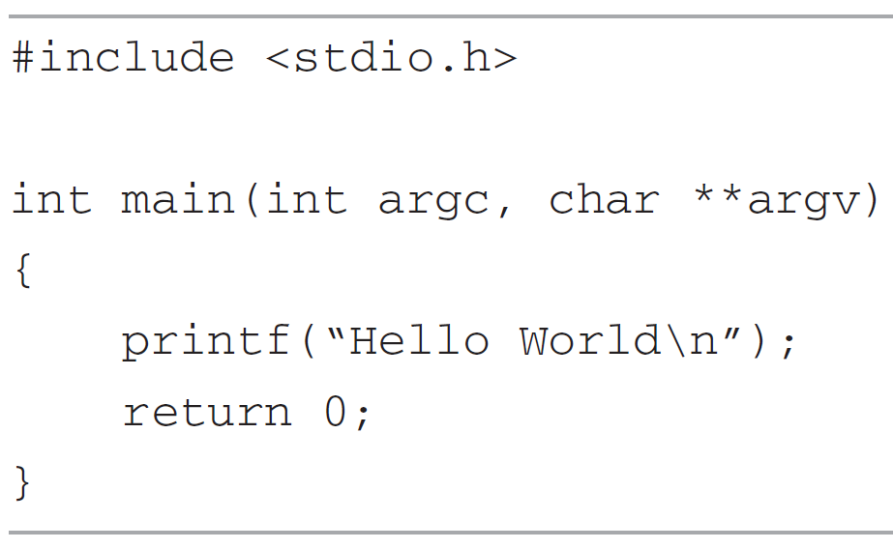
Create your 1st program on Linux
Move file “bt_1” to “bai_tap” folder.
Open “bt_1” with Text editor
Type the source code for the program as follows:
Save as “hello.c”.
On Terminal, move to “bai_tap” folder and type
gcc -o hello hello.c
To run the program, type
./hello

Slide 25
“Hello World” Program Explain
Need to include stdio.h
The code is compiled with GCC compiler
$ gcc -o hello hello.c
And create a binary file named “hello”
hello.c
When we type a command on the command line, the system runs through a preset series of directories, looking for the program we specified.
To override this behavior, we can provide path for the program with “./”
Notes:
-o option informs the compiler of the desired name for the executable (i.e., runnable) file that it produces. The name used in this example is hello, but it could just as easily be anything else desired, such as hello.exe, file1 or Bonjour. If the -o option is omitted, the compiler will give the name a.out to the executable file.
$ arm-linux-gcc –g –o Hello Hello.c

Slide 26
Compile “hello” program
Method 1: type command
gcc -o hello hello.c
Useful when compile simple program
Method 2: Create and run a Makefile
Very useful when build a program that may need various modules/source files.
Method 3: Use Cmake

Slide 27
Makefile
Makefile is a program building tool which runs on Unix, Linux
Makefile simplify the procedure of building a program that may need various modules.
Makefile determine how the modules need to be compiled or recompiled together
For example, let’s assume we have the following source files:
    main.cpp
    hello.cpp
    factorial.cpp
    functions.h

Slide 28
Makefile
We can compile using command:
gcc main.cpp hello.cpp factorial.cpp -o hello
But need to careful about the sequence of the function calls.
What happen if we have few hundred source files?
Makefile:
CC = gcc
CFLAGS = -g
hello: main.cpp hello.cpp factorial.cpp
$(CC) $(CFLAGS) $? -o $@
clean:
-rm *.o hello

Slide 29
Makefile
CC = gcc
CFLAGS = -g
hello: main.cpp hello.cpp factorial.cpp
$(CC) $(CFLAGS) $? -o $@
clean:
rm *.o hello
target
action
Structure of target:
target: dependencies
Action lines should start after a tab
CC, CFLAGS: Macro, need to predefine
  E.g. CC = gcc Program for compiling C programs
CFLAGS = -g Extra flags to give to the C compiler
LDFLAGS = -lGL Extra flags to give to compiler when they
are supposed to invoke the linker
Refer to this link for more detail on macro
https://www.tutorialspoint.com/makefile/makefile_macros.htm

Slide 30
Makefile
CC = gcc
CFLAGS = -g
hello: main.cpp hello.cpp factorial.cpp
$(CC) $(CFLAGS) $? -o $@
clean:
rm *.o hello
target
action
$@ : is the name of the file to be made.
$? : is the names of the changed source files
Run the makefile by command: make or make hello
Clear target: determine what will be done when command make clean is called

Slide 31
Example
What will happen if this makefile is called ?
CC=gcc
OUTPUT=Hello
all:Hello.o display.o
$(CC) -o $(OUTPUT) Hello.o display.o
Hello.o:Hello.c
$(CC) -c Hello.c
display.o:display.c
$(CC) -c display.c

Slide 32
CMake
CMake is a meta build system.
(refer to https://cgold.readthedocs.io/en/latest/overview/cmake-can.html for more info)
Installing Cmake
sudo apt-get -y install cmake
Compile a project with Cmake
  Step 1: create an empty folder and put your code files into it
  Step 2: create a CMakeLists.txt in the same folder
Notes:
CMake is not designed to do the build itself - it generates files which can be used by real native build tool, hence you need to choose such tool(s) and install it if needed.

Slide 33
CMake
  Step 3: Open CMakeLists.txt, insert following lines
cmake_minimum_required(VERSION 2.8)
# set the project name
project(Example)
# Find the require packet (e.g. opencv)
find_package( OpenCV REQUIRED )
# Set the include folder (e.g. opencv include folder)
include_directories( ${OpenCV_INCLUDE_DIRS} )
# Add the executable
add_executable(example example.cpp)
# Add library (e.g. opencv library)
target_link_libraries(example ${OpenCV_LIBS} )

Slide 34
CMake
  Step 4: Build the project
cmake .
make
  Step 5: Recompile if the source code is changed
make

Slide 35
C Library
Library: bunch of files that contain just functions and declaration → Write once use many
C Library is a collection of object files
Types of C library:
  Static libraries: linked into the program during the linking phase of compilation and are not relevant during runtime
  Dynamic libraries: linked by multiple program at the same time during running time

Slide 36
Create a C library
Create static libraries
Step 1: create C source files containing any functions that will be used.
Step 2: Compile these files into objects
gcc -c libraryCode.c -o object.o
Step 3: Create library
ar rc libname.a object.o
Step 4: Linking your program to the libraries, make sure you specify where the library can be found
gcc file.c -L. -lname -o newfile

Slide 37
Create a C library
Create dynamic libraries
Step 1: create C source files containing any functions that will be used.
Step 2: Compile these files into Position Independent Code
gcc -fPIC -c libraryCode.c -o object.o
Step 3: Create library
gcc -shared -o libname.so objfile.o
Step 4: Linking your program to the libraries, make sure you specify where the library can be found
gcc file.c -L. -lname -o newfile

Slide 38
Create a C library
Create dynamic libraries
Step 5: Copy file library.h to /usr/include and
file library.so to /usr/lib
or declare library path in List of Dynamic Dependencies
export LD_LIBRARY_PATH=:/path/to/library.so

Slide 39
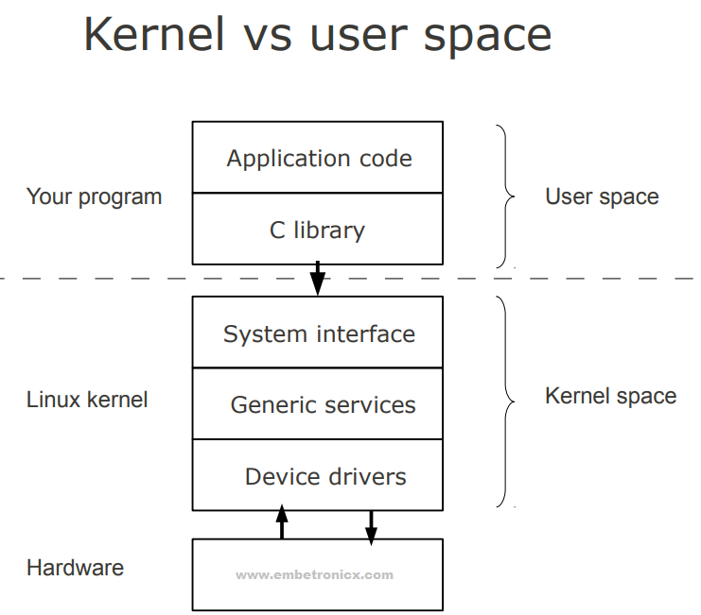
Device Driver
Device driver is a computer program that operates or controls a particular type of device that is attached to a computer
Driver provides a software interface to hardware devices, enabling operating systems and other computer programs to access hardware functions.

Slide 40
Functions of Driver
Isolate the user program from the complexity of the hardware device
  E.g. open, copy a file in hard disk
Provides a consistent user interface to a large variety of hardware device

Slide 41
Device Driver Architecture
Linux lets you add and remove kernel components at runtime
  Provide flexibility
  Enhance upgrade capability
  Module can be stored on media other than root
Linux device driver are broadly classified into 3 basic categories:
  Character devices can be thought of as serial streams of sequential data.
e.g. serial ports and keyboards.
  Block devices are characterized by the capability to read and write blocks of data to and from random locations on an addressable medium
e.g. hard drives and USB Flash drives.
  Network devices This is similar to a block device but is used for transmitting and receiving network packets rather than disk blocks

Slide 42
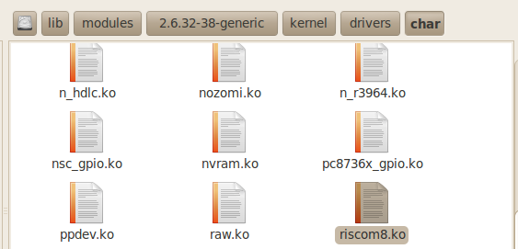
Driver location
Generally, a driver is stored in folder /lib/modules/<kernel_version>/kernel
Driver is stored as *.ko file
List the character and block device drivers that are currently loaded and active by reading /proc/devices
cat /proc/devices

Slide 43
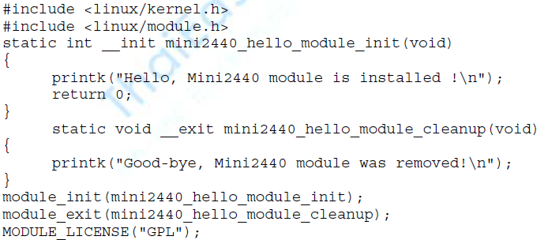
Minimal Device Driver
Notes:
No main() function
No built-in C function
2 fundamental function
  module_init()
  module_exit()
printk : print messeage to kernel log files
Notes:
When the module is loaded, the module-initialization function is called. We specify the initialization function that will be executed on module insertion using the module_init() macro. We declare it as follows: module_init(hello_init);
when we unload the module (using the modprobe -r command), our module exit routine is called. As shown in Listing 8-1, the exit routine is specified using the module_exit() macro. In a real driver, this is where you undo everything that was done on entry, such as freeing any memory or returning the device to a known, harmless state.

Slide 44
Compile a Driver
A device driver must be compiled against the kernel on which it will execute
Method 1: Create a Make file and put it in the same folder with file hello.c
Run the Make file
Load the module
obj-m := hello1.o KDIR := /lib/modules/$(shell uname -r)/build PWD := $(shell pwd) default: $(MAKE) -C $(KDIR) M=$(PWD) modules
Notes:
Sau khi đã có mã nguồn C của driver đơn giản như trên, cần tiến hành biên dịch để tạo ra file module (có đuôi mở rộng .ko, trong trường hợp này là file ofd.ko). Chúng ta sử dụng cách thức biên dịch ở tầng nhân để làm điều này. Cụ thể cần viết một Makefile trong đó thực hiện việc đăng ký thư viện biên dịch ở tầng nhân (kernel build system) từ mã nguồn nhân, và đăng ký driver đang cần biên dịch.

Slide 45
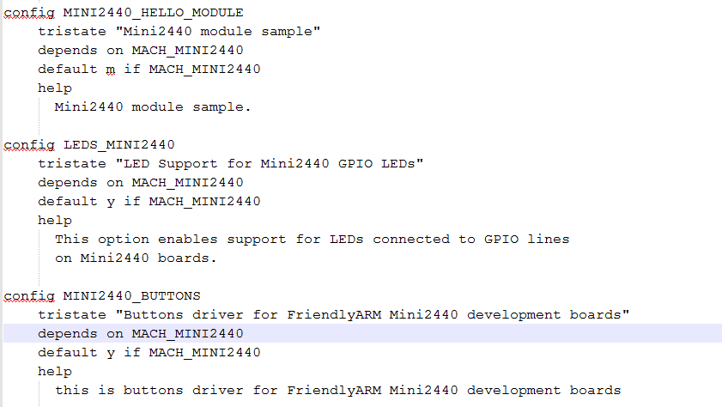
Compile a Driver
Method 2: Add code to the kernel source tree, and do the appropriate configuration
Step 1. Edit the configuration file Kconfig (linux-2.6.32.2/drivers/char/Kconfig)
Notes:
add options to make it appear in the make menuconfig
select the <M> this means that the option should compiled as a module; then press the space will become <*>, which means should this option compiled into the kernel, we choose <M>

Slide 46
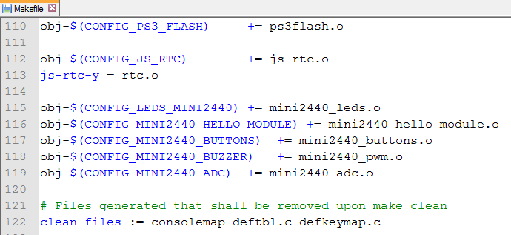
Compile a Driver
Step 2. edit the Makefile in the kernel configuration (linux-2.6.32.2/drivers/char/Makefile)

Slide 47
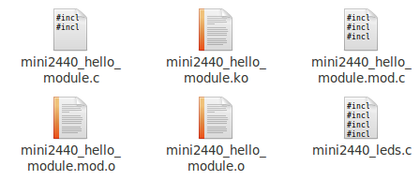
Compile a Driver
Step 3. back to linux-2.6.32.2 root directory, run the makefile
make modules
Then copy the .ko file to /lib/modules/2.6.32.4-FriendlyARM folder on the FriendlyARM board

Slide 48
Loading a driver
modprobe : a utility used to insert a driver into a running kernel.
modprobe mini2440_hello_module
  Similar to insmod
modprobe –r : remove a driver
  Similar to rmmod
rmmod mini2440_hello_module
lsmod : list of driver which is inserted in to the kernel

Slide 49
Practical Device Driver
Beside module_init and module_exit, we need other functions to interface the device with the program
open() : prepare the driver for subsequent operations after the device driver is loaded into a live kernel
release() : provided to clean up after operations are complete
ioctl() : a special system call for nonstandard communication with the driver

Slide 50
Device Nodes and mknod
A device node is a special file type in Linux that represents a device
Linux keep device nodes in a directory called /dev.
This node is mapped to a device driver using the major and minor numbers
  major number (12-bit) maps the device node to a device driver
  minor number (20-bit) tells the driver which interface is being accessed
A dedicated utility is used to create a device node on a file system is called mknod.
mknod /dev/hello1 c 234 0
c means that a char device is to be created
234 major number registered with the kernel
0 minor number, not registered with the kernel
Notes:
After executing this command on our target embedded system, we end up with a new file called /dev/hello1 that represents our device driver module.

Slide 51
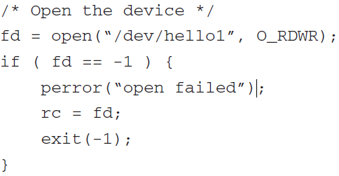
How to use device driver
Call open() function
Call desired command

Slide 52
Source code management
Source code management (SCM) is used to
  track modifications to a source code repository
  revert selected files back to a previous state
  collaborate with developers on other systems
Tracking code modifications
  Manual: use Linux commands such as diff, patch
  Auto: git, github

Slide 53
Source code management
Compare files in Linux
Apply changes:
diff [options] old_file new_file
diff –u old_file new_file > change.diff
patch old_file < change.diff

Slide 54
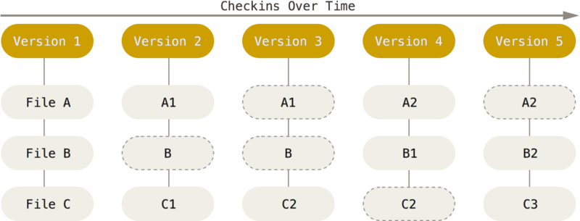
Source code management
Git: Created by Linus Torvald in 2005
Notes:
With Git, every time you commit, or save the state of your project, Git basically takes a picture of what all your files look like at that moment and stores a reference to that snapshot. To be efficient, if files have not changed, Git doesn’t store the file again, just a link to the previous identical file it has already stored. Git thinks about its data more like a stream of snapshots.

Slide 55
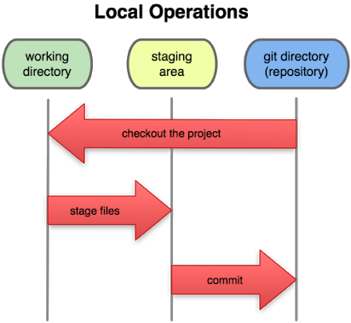
Source code management
Git:

